Slide 1
Flex generators

Slide 2
The Lex and Flex Scanner Generators
Lex and its newer cousin flex are scanner generators
Scanner generators systematically translate regular definitions into C source code for efficient scanning
Generated code is easy to integrate in C applications

Slide 3
Creating a Lexical Analyzer with Lex and Flex
lex source program lex.l
lex (or flex)
lex.yy.c
C compiler
lex.yy.c
a.out
a.out
input stream
sequence of tokens

Slide 4
Lex Specification
A lex specification consists of three parts: regular definitions, C declarations in {} %% translation rules %% user-defined auxiliary procedures
The translation rules are of the form: p₁ { action₁ } p₂ { action₂ } … p_{n} { action_{n} }

Slide 5
Regular Expressions in Lex
x match the character x \. match the character . “string” match contents of string of characters . match any character except newline ^ match beginning of a line $ match the end of a line [xyz] match one character x, y, or z (use \ to escape -) [^xyz]match any character except x, y, and z [a-z] match one of a to z r* closure (match zero or more occurrences) r+ positive closure (match one or more occurrences) r? optional (match zero or one occurrence) r₁r₂ match r₁ then r₂ (concatenation) r₁|r₂ match r₁ or r₂ (union) ( r ) grouping r₁/r₂ match r₁ when followed by r₂ {d} match the regular expression defined by d

Slide 6
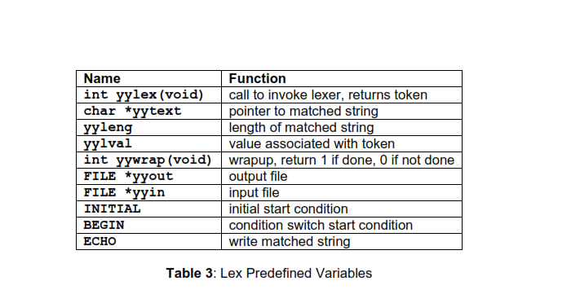

Slide 7
Example Lex Specification 1
Contains the matching lexeme
%{
#include <stdio.h>
%}
%%
[0-9]+ { printf(“%s\n”, yytext); }
.|\n { } %%
main()
{ yylex();
}
Translation rules
Invokes the lexical analyzer
lex spec.l gcc lex.yy.c -ll ./a.out < spec.l

Slide 8
Example Lex Specification 2
%{
#include <stdio.h>
int ch = 0, wd = 0, nl = 0;
%} delim [ \t]+
%%
\n { ch++; wd++; nl++; }
^{delim} { ch+=yyleng; }
{delim} { ch+=yyleng; wd++; }
. { ch++; }
%%
main()
{ yylex();
printf("%8d%8d%8d\n", nl, wd, ch);
}
Regular definition
Translation rules

Slide 9
Example Lex Specification 3
%{
#include <stdio.h>
%} digit [0-9] letter [A-Za-z] id {letter}({letter}|{digit})*
%%
{digit}+ { printf(“number: %s\n”, yytext); }
{id} { printf(“ident: %s\n”, yytext); }
. { printf(“other: %s\n”, yytext); }
%%
main()
{ yylex();
}
Regular definitions
Translation rules

Slide 10
Example Lex Specification 4
%{ /* definitions of manifest constants */
#define LT (256) …
%} delim [ \t\n] ws {delim}+ letter [A-Za-z] digit [0-9] id {letter}({letter}|{digit})* number {digit}+(\.{digit}+)?(E[+\-]?{digit}+)? %% {ws} { } if {return IF;} then {return THEN;} else {return ELSE;} {id} {yylval = install_id(); return ID;} {number} {yylval = install_num(); return NUMBER;} “<“ {yylval = LT; return RELOP;} “<=“ {yylval = LE; return RELOP;}
“=“ {yylval = EQ; return RELOP;}
“<>“ {yylval = NE; return RELOP;} “>“ {yylval = GT; return RELOP;}
“>=“ {yylval = GE; return RELOP;}
%%
int install_id() …
Return token to parser
Token attribute
Install yytext as identifier in symbol table

